Slide 1
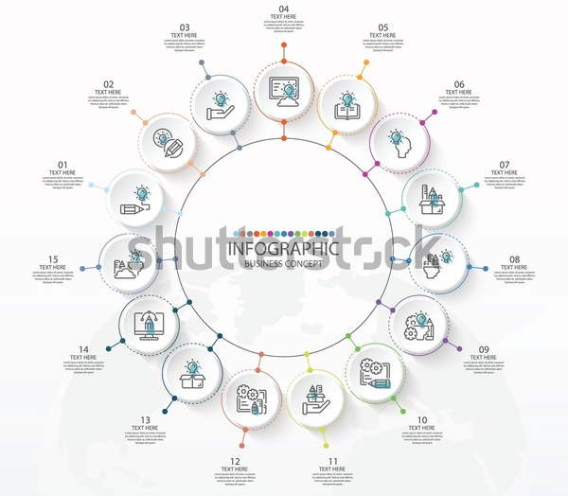
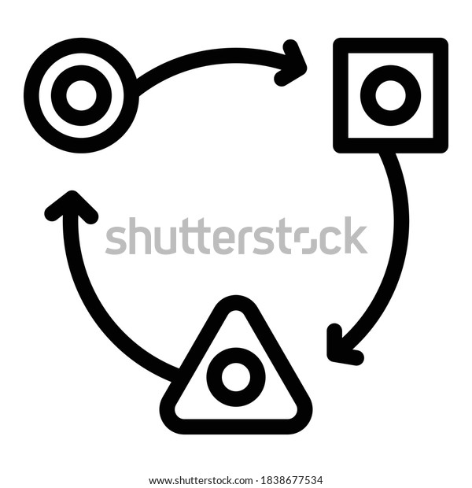

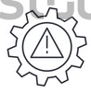







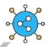


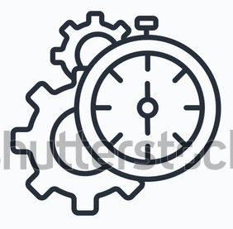

Adaptabilidad
Usabilidad
Análisis de riesgos
Seguridad
Auditoría
Robustez
Automatización de pruebas
Operabilidad
Calidad
Interoperabilidad
Coexistencia
Integración
Cumplimiento
Eficiencia
Depuración

Slide 2
https://www.shutterstock.com/es/image-vector/basic-circle-infographic-template-15-steps-2043166697
https://www.shutterstock.com/es/image-vector/adaptation-icon-outline-vector-web-design-1838677534
https://www.shutterstock.com/es/image-vector/problem-solving-icons-editable-stroke-creativity-1826108366
https://www.shutterstock.com/es/image-vector/risk-evaluation-outline-icon-thin-line-1866757501
https://www.shutterstock.com/es/image-vector/software-integration-test-automation-line-vector-1209604684
https://www.shutterstock.com/es/image-vector/rosette-stamp-icon-vector-design-template-1939061152
https://www.shutterstock.com/es/image-vector/shareware-concept-icons-software-business-model-2202153103
https://www.flaticon.es/icono-gratis/actualizacion-del-sistema_2563569
https://www.shutterstock.com/es/image-vector/debug-magnifying-glass-line-icon-vector-2040778451
https://www.shutterstock.com/es/image-vector/efficiency-outline-icon-simple-linear-element-1569345967
https://www.shutterstock.com/es/image-vector/set-update-system-icons-gears-loading-1810431700
https://www.shutterstock.com/es/image-vector/colorful-icon-interoperability-1244095495
https://www.shutterstock.com/es/image-vector/management-icon-teamwork-business-team-company-1926707045
https://www.shutterstock.com/es/image-vector/service-tools-icon-vector-pictogram-style-1805777254
https://www.shutterstock.com/es/image-vector/shield-icon-security-lock-protection-secure-708216937
https://www.shutterstock.com/es/image-vector/usability-vector-icon-622965869

